Slide 1
13 - Filtering
Dr. Hamish Carr & Dr. Rafael Kuffner dos Anjos

Slide 2
Agenda
Images
Sampling
Filtering
FFT

Slide 3

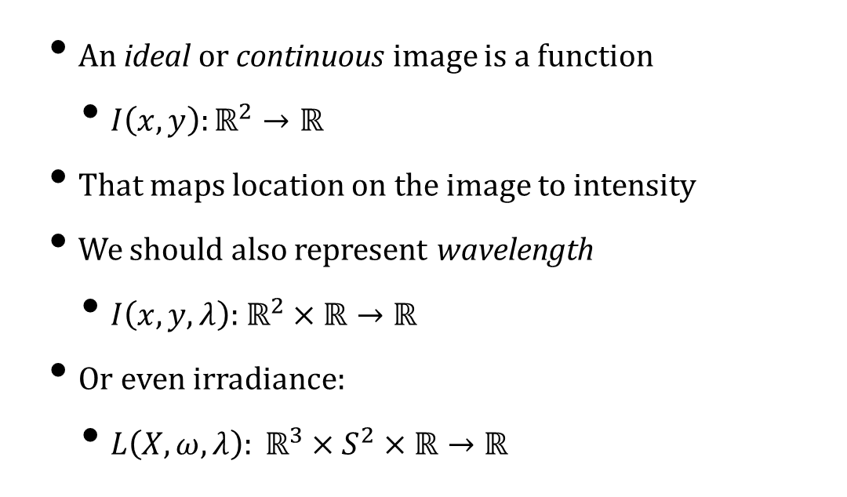
What Is an Image?
An ideal or continuous image is a function
$I\left(x,y\right):ℝ^{2}→ℝ$
That maps location on the image to intensity
We should also represent wavelength
$I\left(x,y,λ\right):$ $ℝ^{2}×ℝ→ℝ$
Or even irradiance:
$L\left(X,ω,λ\right): ℝ^{3}×S^{2}×ℝ→ℝ$
COMP 5812M: Foundations of Modelling & Rendering

Slide 4
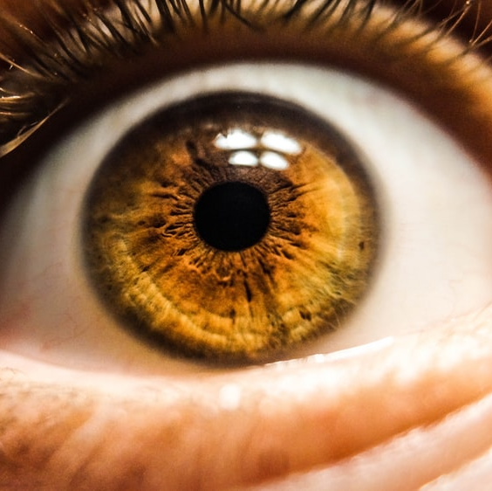

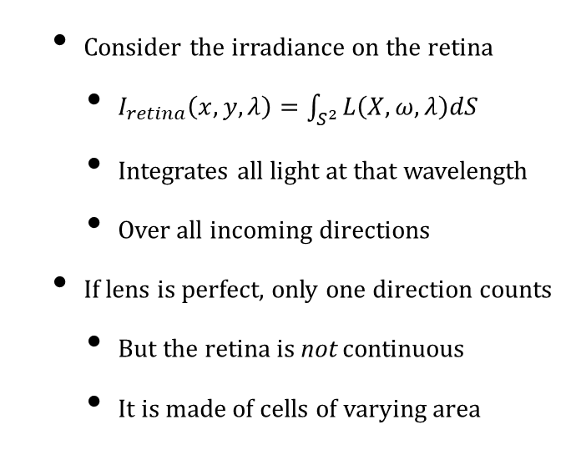
On the Retina
Consider the irradiance on the retina
$I_{retina}\left(x,y,λ\right)=\int_{S^{2}}^{ }{L\left(X,ω,λ\right)dS}$
Integrates all light at that wavelength
Over all incoming directions
If lens is perfect, only one direction counts
But the retina is not continuous
It is made of cells of varying area
COMP 5812M: Foundations of Modelling & Rendering

Slide 5
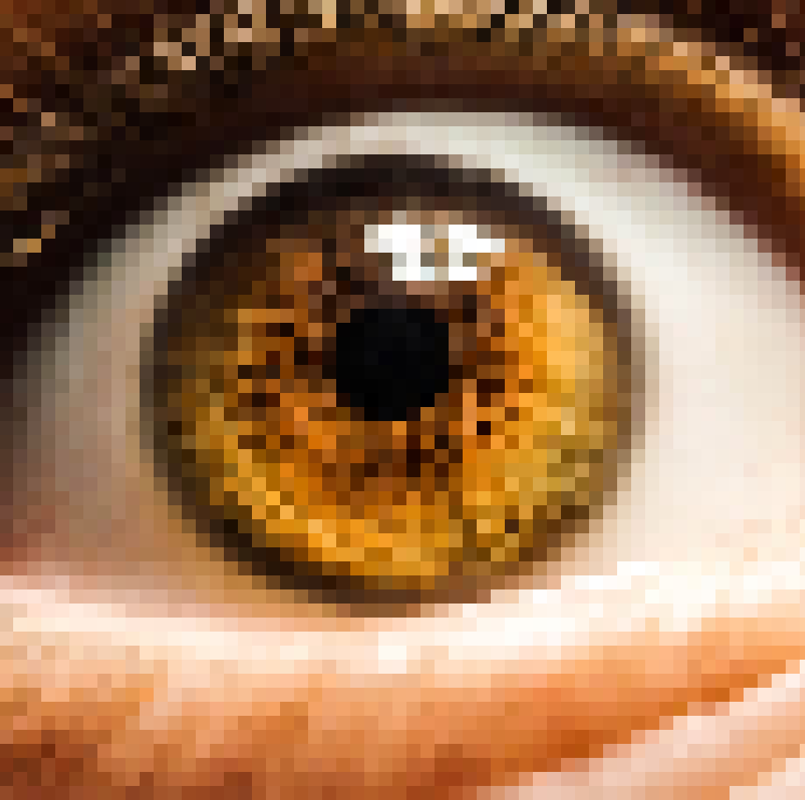
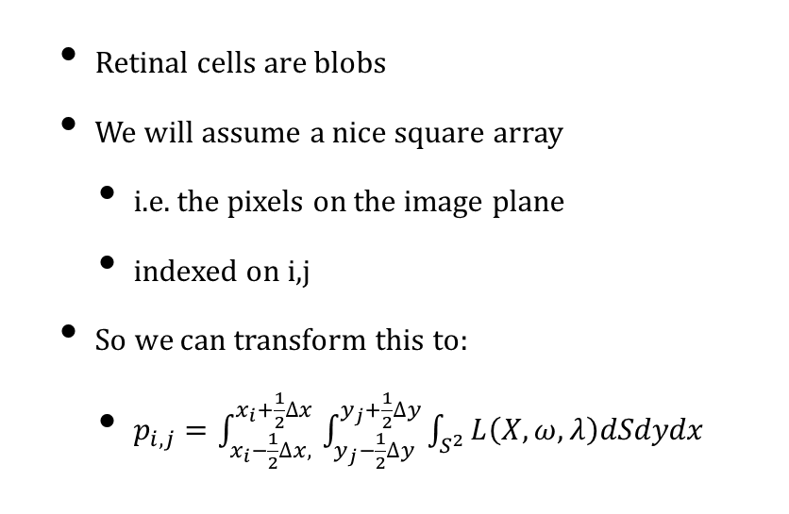
Discrete Retina / Image
Retinal cells are blobs
We will assume a nice square array
i.e. the pixels on the image plane
indexed on i,j
So we can transform this to:
$p_{i,j}=\int_{x_{i}−\frac{1}{2}∆x, }^{x_{i}+\frac{1}{2}∆x}{\int_{y_{j}−\frac{1}{2}∆y}^{y_{j}+\frac{1}{2}∆y}{\int_{S^{2}}^{ }{L\left(X,ω,λ\right)dSdydx}}}$
COMP 5812M: Foundations of Modelling & Rendering

Slide 6
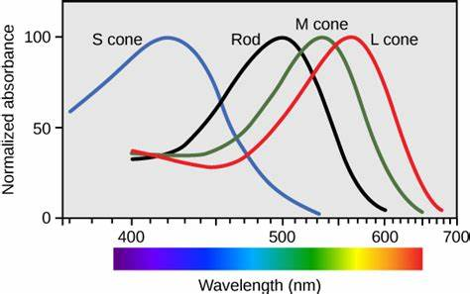
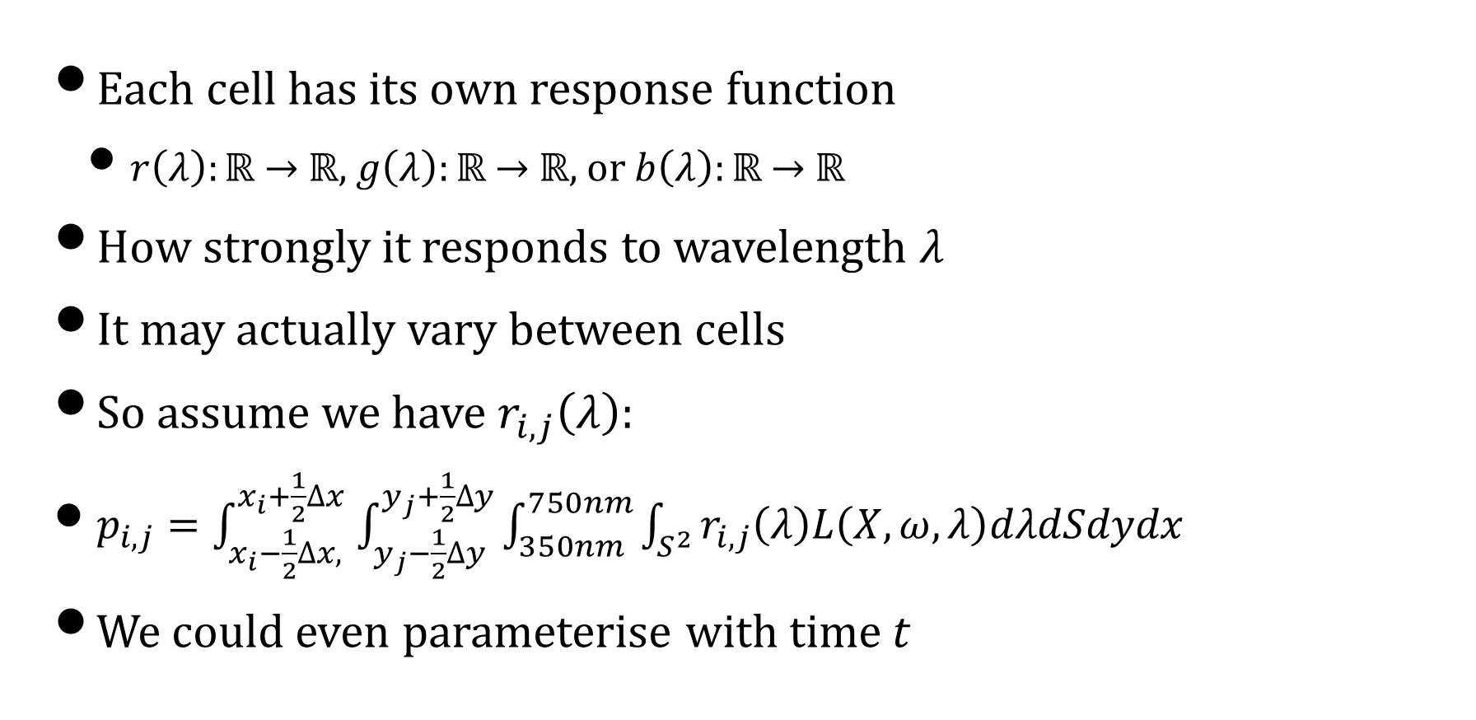
Colour Response
Each cell has its own response function
$r\left(λ\right):ℝ$ $→$ $ℝ$, $g\left(λ\right):ℝ$ $→$ $ℝ$, or $b\left(λ\right):ℝ$ $→$ $ℝ$
How strongly it responds to wavelength $λ$
It may actually vary between cells
So assume we have $r_{i,j}\left(λ\right)$:
$p_{i,j}=\int_{x_{i}−\frac{1}{2}∆x, }^{x_{i}+\frac{1}{2}∆x}{\int_{y_{j}−\frac{1}{2}∆y}^{y_{j}+\frac{1}{2}∆y}{\int_{350nm}^{750nm}{\int_{S^{2}}^{ }{r_{i,j}\left(λ\right)L\left(X,ω,λ\right)dλdSdydx}}}}$
We could even parameterise with time t

Slide 7

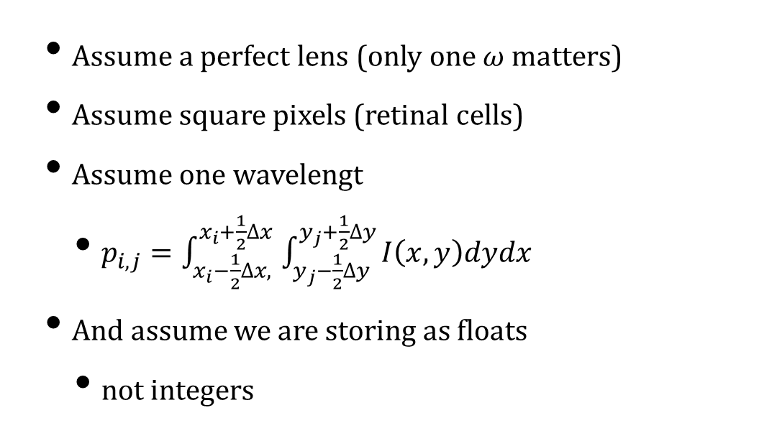
Assumptions
Assume a perfect lens (only one $ω$ matters)
Assume square pixels (retinal cells)
Assume one wavelengt
$p_{i,j}=\int_{x_{i}−\frac{1}{2}∆x, }^{x_{i}+\frac{1}{2}∆x}{\int_{y_{j}−\frac{1}{2}∆y}^{y_{j}+\frac{1}{2}∆y}{I\left(x,y\right)dydx}}$
And assume we are storing as floats
not integers
COMP 5812M: Foundations of Modelling & Rendering

Slide 8

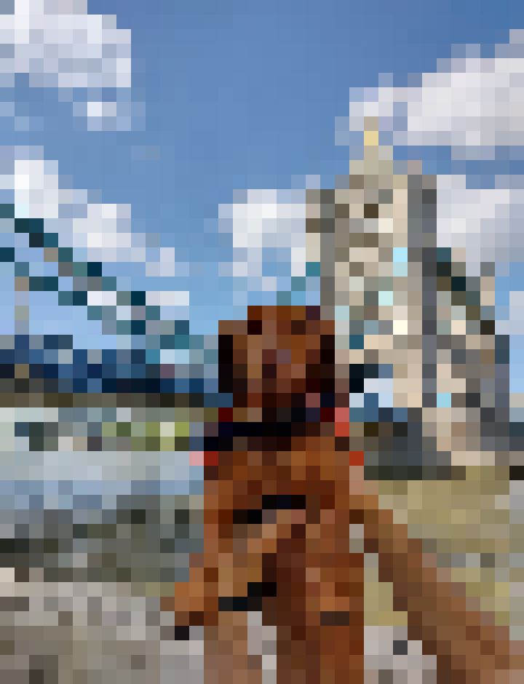
Sampling
We never actually compute this
although perhaps we should
Instead, we sample the function
measure the light at the centre of the pixel
Then display the same value across the pixel
And this leads immediately to errors
In particular, aliasing
COMP 5812M: Foundations of Modelling & Rendering

Slide 9
Reconstruction
Suppose we measure a function at 10 points
Can we reconstruct the function?
i.e. recover the continuous version
Only if there is a unique representation
And it is easy to show there isn't
COMP 5812M: Foundations of Modelling & Rendering

Slide 10
1-D Example
Both green and red have the same samples
Which one is right?
The screen does a third thing
Because of hardware

Slide 11
Aliasing
A general phenomenon
Caused by not enough samples
Reconstruction dominated by error
We know this should be a straight line
But it is jaggy when discretised
COMP 5812M: Foundations of Modelling & Rendering

Slide 12
Solution (Goal)
Aliased
Anti-aliased
Far away
Replace it with a grey-level
Overlap between line of width 1 & pixel

Slide 13
Immediate Use: Fonts
TrueType
(RGB in different columns, eg LCD)
Binary Font
Anti-aliased
Using Greyscale

Slide 14
Aliased Motion
Object moves 2 pixels in 4 time steps
But it looks like it speeds up in the middle
Really just the same problem
COMP 5812M: Foundations of Modelling & Rendering

Slide 15
Solution
Object
Pixel
Product
Sample
Treat the object as a function itself
Combine the function with the pixel

Slide 16

Mathematically
Clearly, this varies with the offset
between object and pixel
We express this as a function (of course)
And an operation called convolution
COMP 5812M: Foundations of Modelling & Rendering

Slide 17
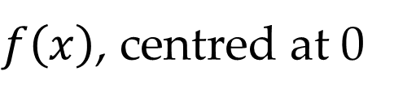
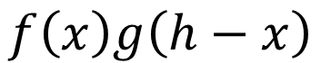
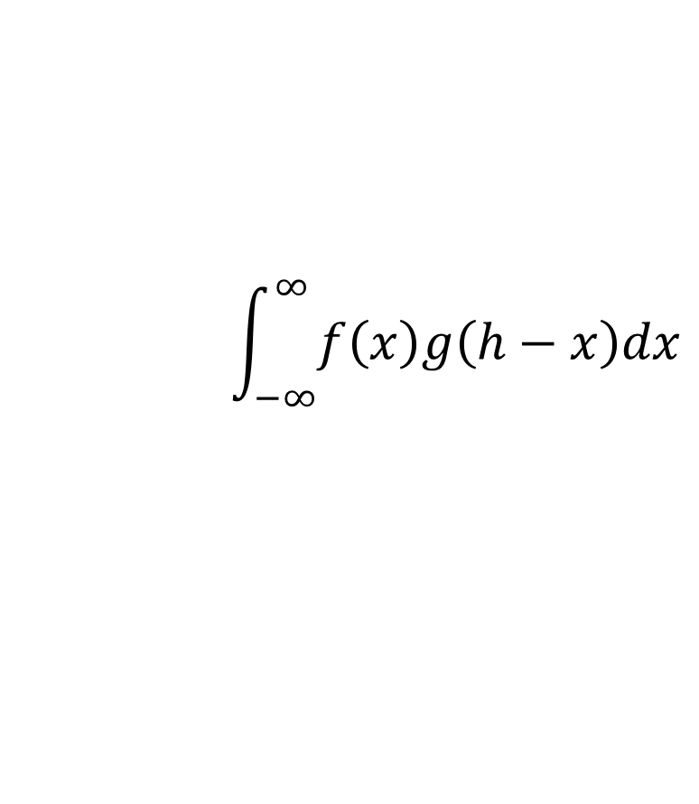
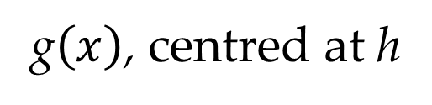
Convolution
Object
$f\left(x\right)$, centred at 0
Pixel
g$\left(x\right)$, centred at h
Product
$$f\left(x\right)g\left(h−x\right)$$
Sample
$$\int_{−∞}^{∞}{f\left(x\right)g\left(h−x\right)dx}$$
Convolution works with any functions
and has nice mathematical properties

Slide 18
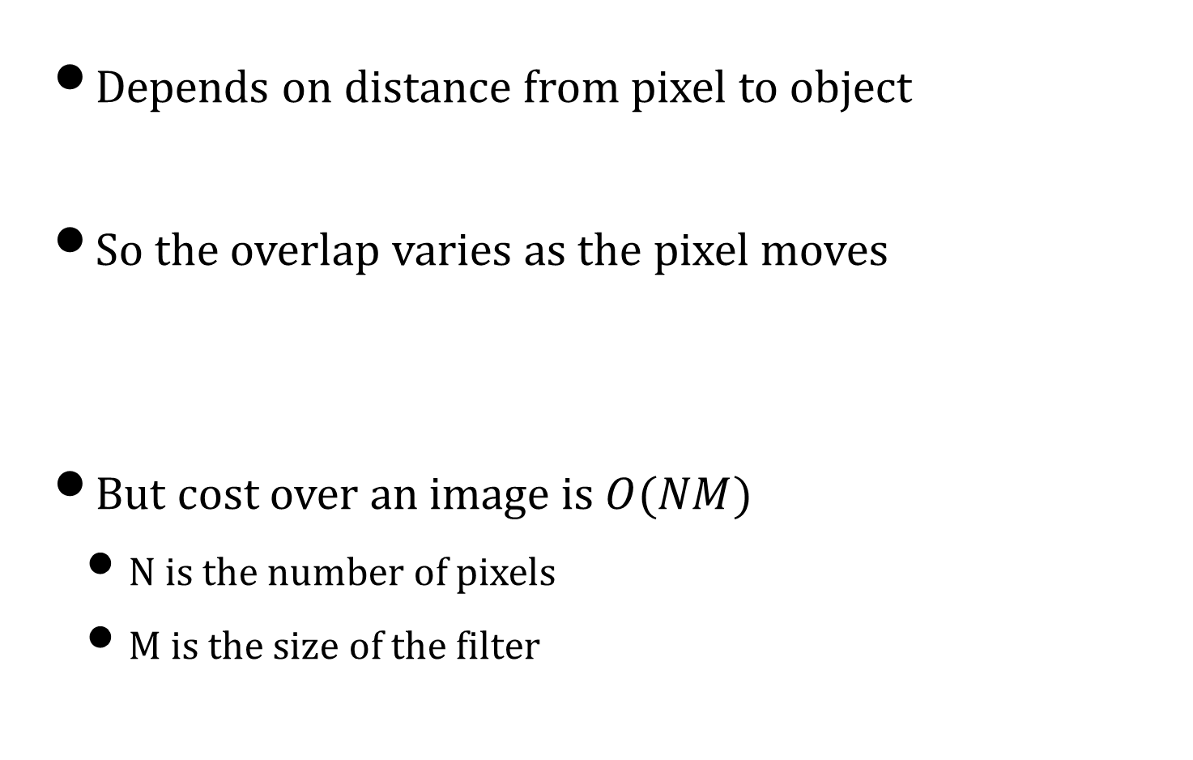
Filtering
Depends on distance from pixel to object
So the overlap varies as the pixel moves
But cost over an image is $O(NM)$
N is the number of pixels
M is the size of the filter

Slide 19


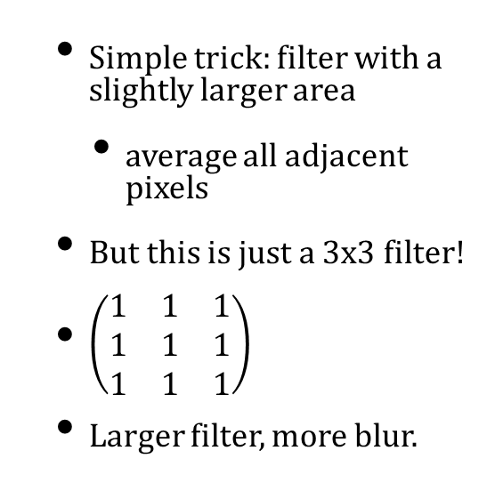
Blurring
Simple trick: filter with a slightly larger area
average all adjacent pixels
But this is just a 3x3 filter!
$\left(\begin{matrix}1 & 1 & 1 \\ 1 & 1 & 1 \\ 1 & 1 & 1\end{matrix}\right)$
Larger filter, more blur.
COMP 5812M: Foundations of Modelling & Rendering

Slide 20
Sampling Theory
The next piece of the puzzle
Treats the image like an electrical signal
Or an audio signal
Breaks it down into frequencies
i.e. how rapidly it changes
Expressed with Fourier analysis

Slide 21
Fourier Analysis
Any periodic function can be broken down
Into a sum of sines & cosines
In the complex plane
Based on our samples
We will have to assume a band limit
I.e. a maximum spatial frequency
y = sin(11x)
y = sin(x)

Slide 22
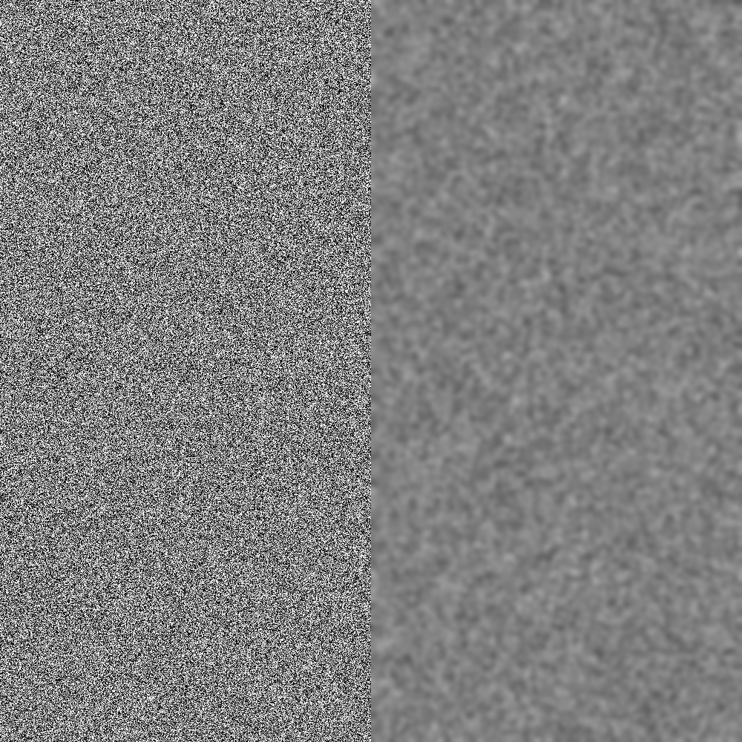
How can we see that in images?
Each pixel is a sample of your signal
Low resolution images:
band limited to low frequencies
High resolution images:
Low frequency changes happen over several pixels
High frequency changes happen over fewer pixels
3x downscale
Seems uniform!

Slide 23
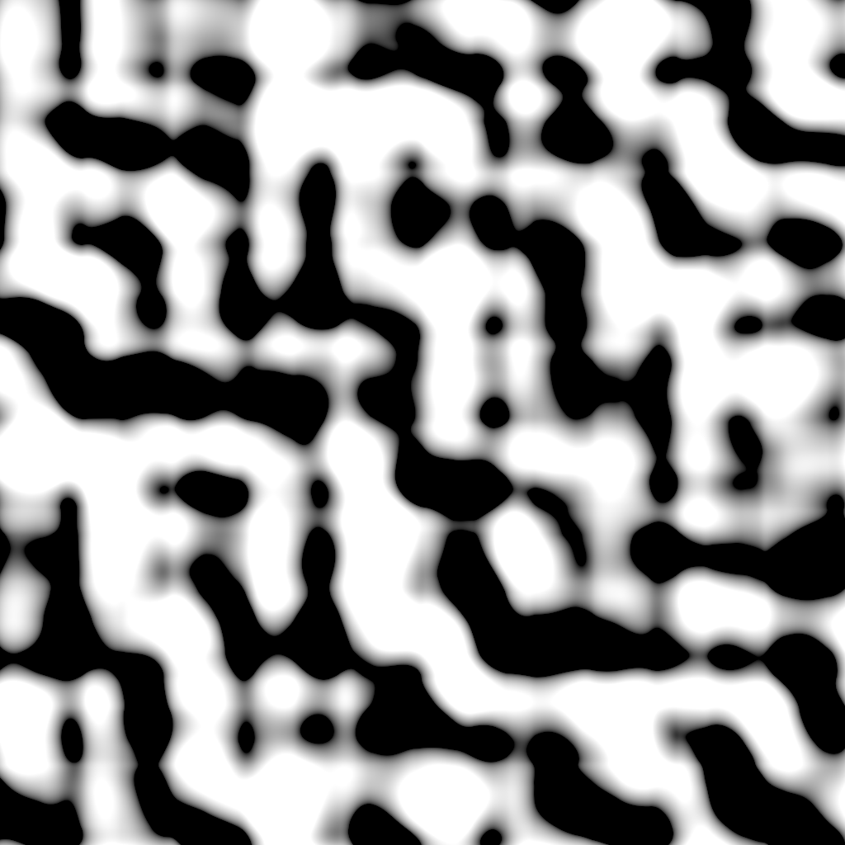

Example (Perlin noise)
Low frequency
High frequency

Slide 24
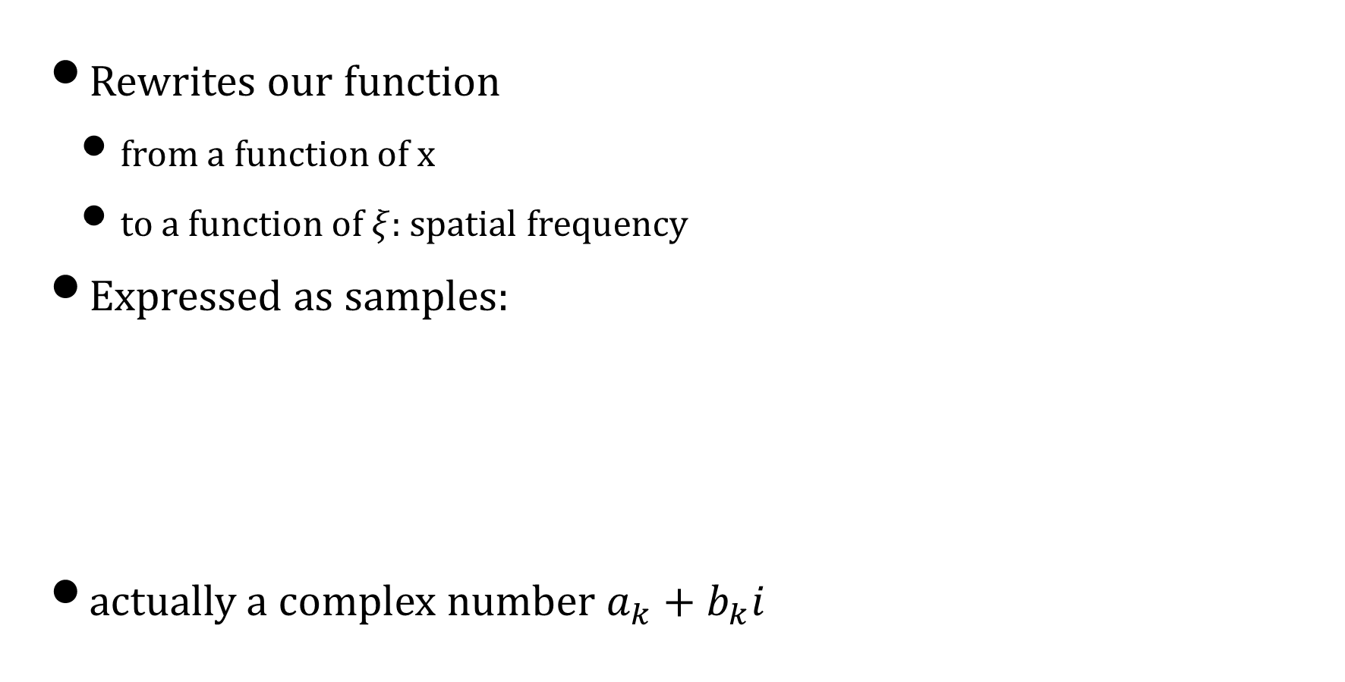
Fourier Transform
Rewrites our function
from a function of x
to a function of $ξ$: spatial frequency
Expressed as samples:
actually a complex number $a_{k}+b_{k}i$

Slide 25
Frequency Filtering: 1D
One Row
Fourier Transform
Box Filter
After Filtering

Slide 26
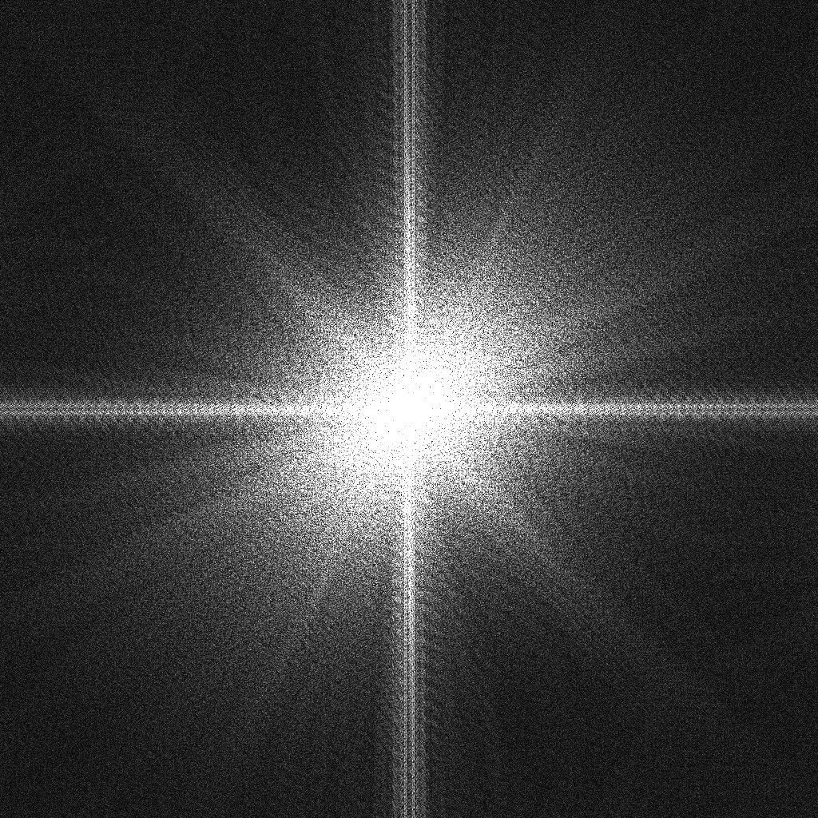

2D FFT
We can plot the 2D fft to an image.
Typically shifted to the center
Lower frequencies in the center
Higher frequencies going towards the edges
Oriented lines mean frequencies of that orientation

Slide 27


Filtering 2D
Filters would look like this
Can easily separate oriented frequencies as well
Convolution = multiplication in Fourier domain.
COMP 5812M: Foundations of Modelling & Rendering

Slide 28
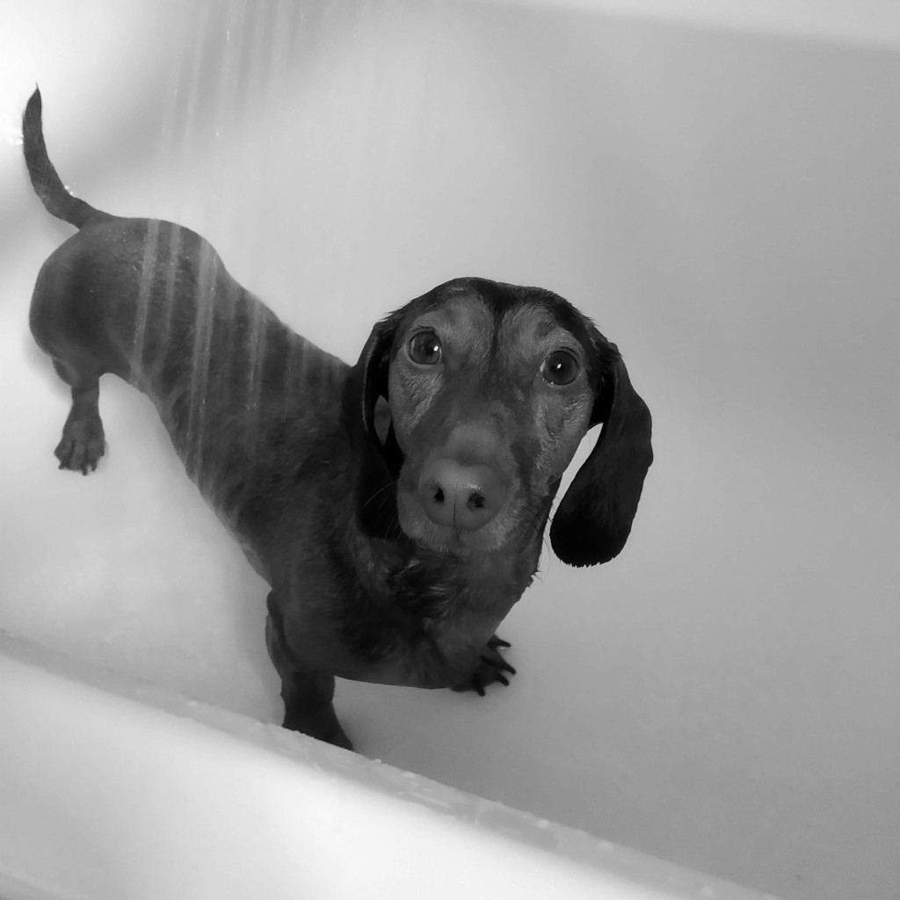

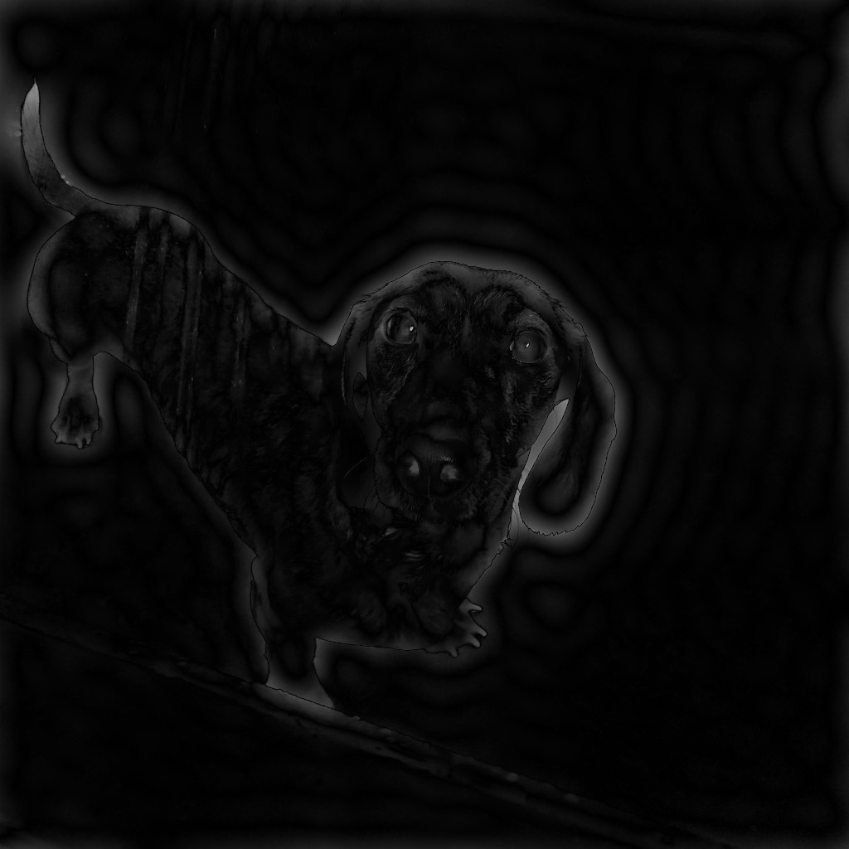
Results
Lola
Low frequency
High frequency
Ringing artifacts!

Slide 29
Sinc Filter
What does this filter look like?
In the spatial domain
It becomes the sinc filter
Ideal filter that removes frequencies above a certain cutoff, without affecting lower ones.

Slide 30
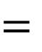

Sampling
$$×$$
$$=$$
Sampling
Function
Sampled
Function
Taj Mahal
Fourier
Transform
Fourier
Transform

Slide 31
More generally
Mipmapping is a special case
We need a more general solution
But scaling up & scaling down are different
Scaling up – use the sinc filter if possible
Scaling down – increases the frequency
And no longer band-limited

Slide 32
Scaling Up
Original Signal
Rescaled Signal
Spatial
Frequency
Increasing spatial resolution
Decreasing frequency resolution
Bandwidth limit is preserved

Slide 33

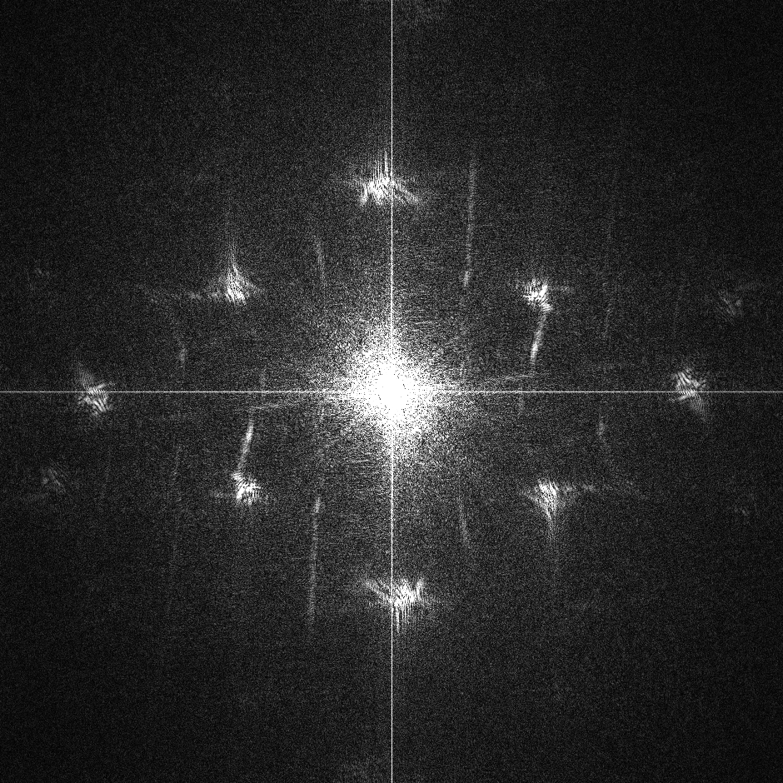

Example of upscale
Image
FFT
FFT of upscale
FFT is “shrinked”
COMP 5812M: Foundations of Modelling & Rendering

Slide 34
Scaling in Two Dimensions
Just do one dimension at a time
Either order produces same result (separable)
COMP 5812M: Foundations of Modelling & Rendering

Slide 35
Terminology
Support of f is interval where it is nonzero
Can be finite (e.g. box) or infinite (e.g. sinc)
Images typically have finite support
So scaling up isn't usually a problem
And sinc filters preserve detail
Bilinear filtering isn't as good at this
But textures are more often scaled down
COMP 5812M: Foundations of Modelling & Rendering

Slide 36
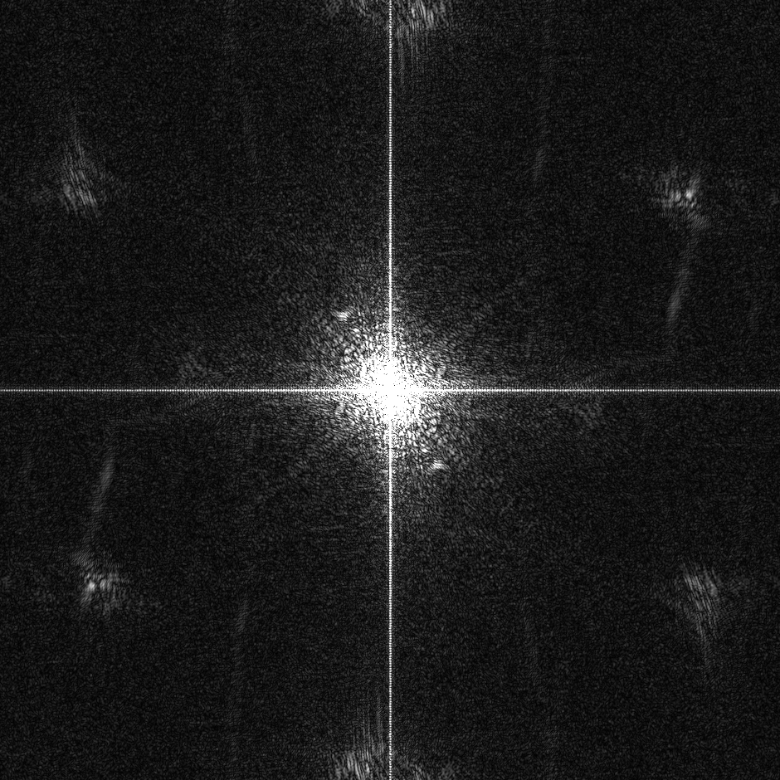
Scale down
Depends on the method of re-scale
Limited our band to show higher frequencies
But can introduce new sharp details
COMP 5812M: Foundations of Modelling & Rendering

Slide 37
Scaling Down
We have to add an extra box filter
In order to preserve the bandlimit
Ideal
Optimised

Slide 38
Boundary Effects
What happens at the image boundary?
Not enough pixels for filter
So we have to invent / assume extra pixels
And each method has it's side effects
COMP 5812M: Foundations of Modelling & Rendering

Slide 39
Boundary Assumptions
We can also limit the reconstruction filter
Or we can cheat & re-weight
COMP 5812M: Foundations of Modelling & Rendering

Slide 40
Side-Effects
Extend by Zeroes:
Leads to darkening around edge of image
Extend by Reflection:
Not necessarily realistic
Extend by Constants:
Tends to smear boundary inwards
Finite Support Filter
Impossible to do in both domains at once

Slide 41

Band-Limited Filters
We want a wider filter than linear
But not as wide as sinc
Iterate the box (tent) filter multiple times
Leads to cubic B-spline filters
See 5821M for discussion
COMP 5812M: Foundations of Modelling & Rendering

Slide 42
The Standard Hack
Each filter assigns weights to pixels
And should guarantee they sum to 1
(otherwise we lose/gain brightness overall)
Omit filter pixels outside the image
This drops the sum below 1
So divide by the sum of the weights kept
Result: interpolation only uses valid pixels

Slide 43
Images by:
S2: Matt moloney
S3: Kalea Jerielle
S6: Zachary Keimig
S40: Nathan dumlao

